Slide 1
Bag of Words

Slide 2
Bag of Words
S1 – He is a good boy.
S2 – She is a good girl.
S3 – Boy & girl are good.
After removing stop words and converting the sentences to lowercase:
S1 – good boy
S2 – good girl
S3 – Boy girl good

Slide 3
Bag of Words
Histogram:
Features
 | F1 | F2 | F3
 | good | boy | girl
S1 | 1 | 1 | 0
S2 | 1 | 0 | 1
S3 | 1 | 1 | 1
Words | Frequency
good | 3
boy | 2
girl | 2

Slide 4
Disadvantages
Not able to derive which word is more important as representation is the same.
Eg: ‘good’ & ‘boy’ both have the same value ‘1’, when ‘good’ is more important.

Slide 5
Word Embeddings

Slide 6
Naïve Approaches
1. Simple way is to assign integers to a dictionary of words.
Eg:
a
able
bug
cat
.
.
.
.
zebra
1
2
3
4
.
.
.
.
1000

Slide 7
Disadvantage
Sematic relation is not recorded
Eg: There is no reason for a < able < bug
1 2 3

Slide 8
Naïve Approaches
2. Another approach is to simply use one-hot encoding for each of the words.
Eg: a - zebra -
1
0
.
.
.
.
.
0
0
0
.
.
.
.
.
1

Slide 9
Disadvantage
It is a very simple way of encoding which has no implied ordering.
Lot of space and processing time.
No embedding meaning.

Slide 10
Word Vector
Rage

Slide 11
Process of word embedding
We need :
Corpus (words in context)
Embedding method (Machine Learning Model)
Self-Supervised
Unsupervised + Supervised
Corpus is unlabelled
Data itself is necessary to provide context which would ordinarily make up the labels,

Slide 12
Word2Vec
Objective is to have words with similar context occupy close spatial positions.
Eg: S1 = Have a good day. S2- Have a great day.
Have = [1,0,0,0,0]`; a=[0,1,0,0,0]` ; good=[0,0,1,0,0]` ; great=[0,0,0,1,0]` ; day=[0,0,0,0,1]` (` represents transpose)
If we try to visualize these encodings, we can think of a 5-dimensional space, where each word occupies one of the dimensions and has nothing to do with the rest (no projection along the other dimensions). This means ‘good’ and ‘great’ are as different as ‘day’ and ‘have’, which is not true.

Slide 13
Word2Vec
Two methods:
CBOW (Continuous Bag of Words.
Skip Gram.

Slide 14
CBOW
This method takes the context of each word as the input and tries to predict the word corresponding to the context.
Eg: Hope can set you free
Here, ‘hope’ and ‘set’ are the inputs and can is predicted, considering the window size as 3.
In other words, this method is used to predict the middle word considering the surrounding context words.

Slide 15
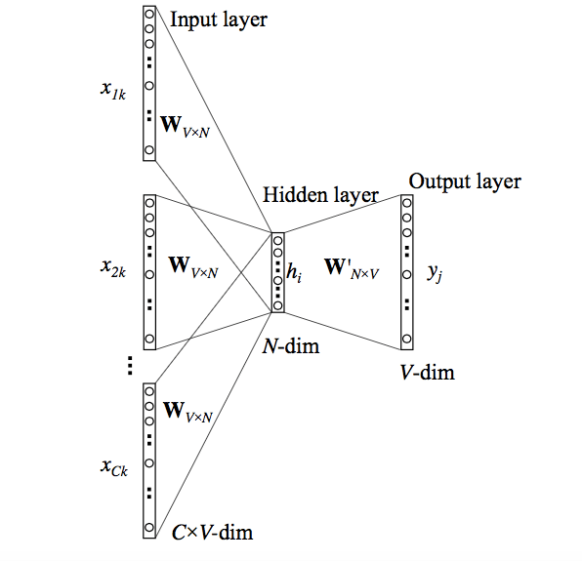

Slide 16
Skip Gram
Here, we input the target word into the network. The model outputs C probability distributions for the surrounding context words.
For each context position, we get C probability distributions of V probabilities, one for each word.
Eg: Hope can set you free
Now, ‘can’ is inputted into the model and the probability distributions for the context words are outputted.

Slide 17
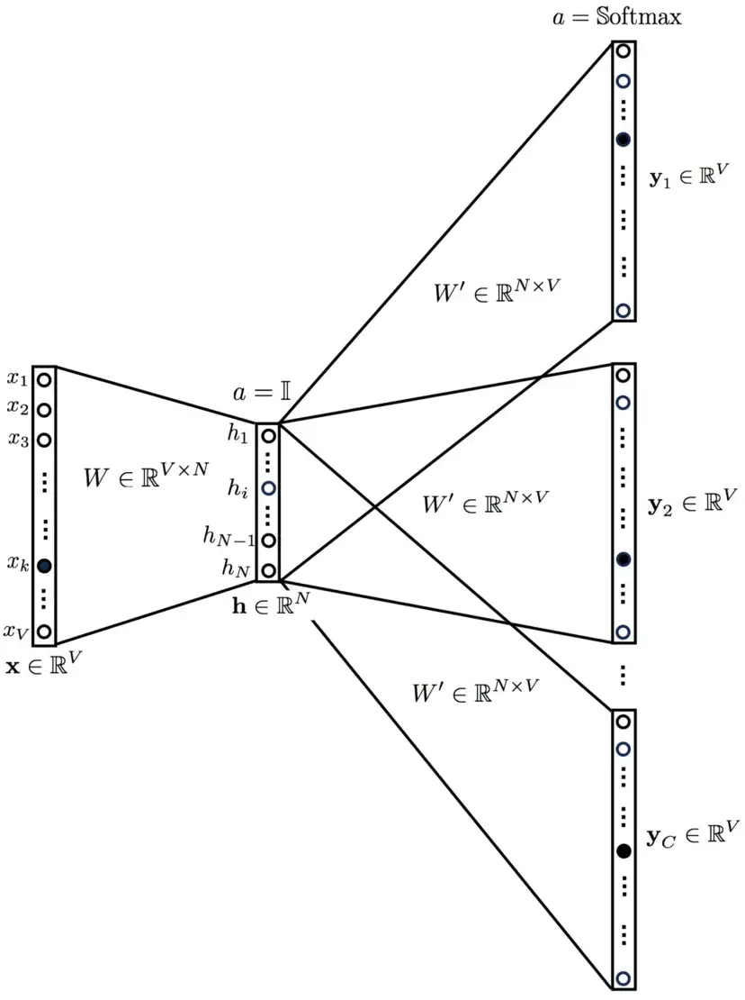

Slide 18
Which method is better?
Both have their own advantages and disadvantages. Skip Gram works well with small amount of data and is found to represent rare words well.
On the other hand, CBOW is faster and has better representations for more frequent words.

Slide 19
How to obtain the word vectors?
One can multiply the one-hot vectors of each words with the weight vector obtained after training to get the word embedding for that particular word.

Slide 20
Seq2Seq model
Machine translation

Slide 21
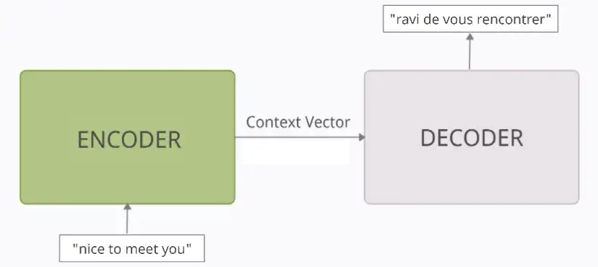
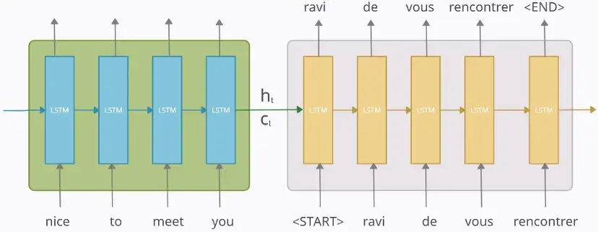
Architecture

Slide 22
Example of Machine Translation
X = “nice to meet you” → Y_true = “ravi de vous rencontrer”
X = “nice to meet you” → Y_true = “<START> ravi de vous rencontrer <END>”
Next the input and output data is vectorized using one-hot-encoding (ohe). Let the input and output be represented as
X = (x1, x2, x3, x4) → Y_true = (y0_true, y1_true, y2_true, y3_true, y4_true, y5_true)

Slide 23
Vectorizing the Data
For input X
‘nice’ → x1 : [1 0 0 0]
‘to’ → x2 : [0 1 0 0 ]
‘meet’ →x3 : [0 0 1 0]
‘you’ → x4 : [0 0 0 1]
For Output Y_true
‘<START>’ → y0_true : [1 0 0 0 0 0]
‘ravi’ → y1_true : [0 1 0 0 0 0]
‘de’ → y2_true : [0 0 1 0 0 0]
‘vous’ → y3_true : [0 0 0 1 0 0]
‘rencontrer’ → y4_true : [0 0 0 0 1 0]
‘<END>’ → y5_true : [0 0 0 0 0 1]

Slide 24
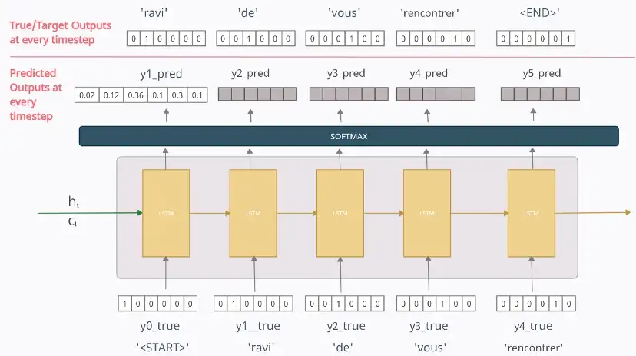
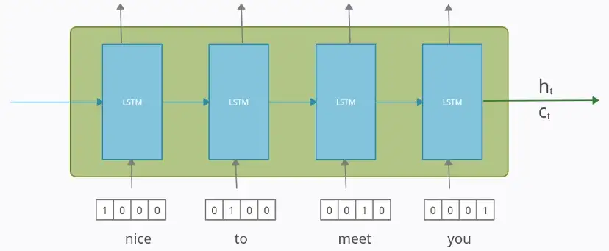
Encoder and Decoder

Slide 25
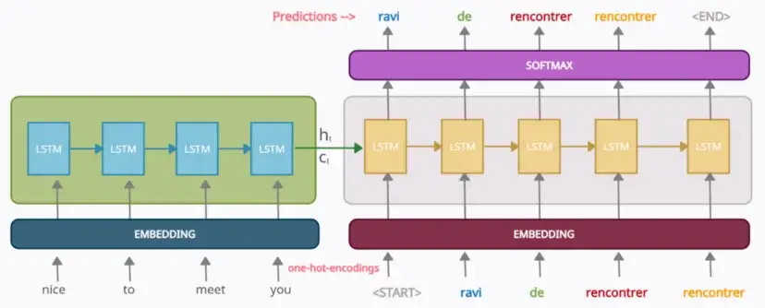
Working

Slide 26
Disadvantages
Encoder and decoder usually do not perform well with longer sentences.

Slide 27
Attention Models

Slide 28
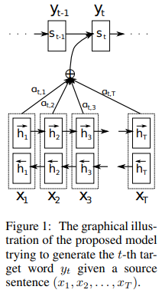
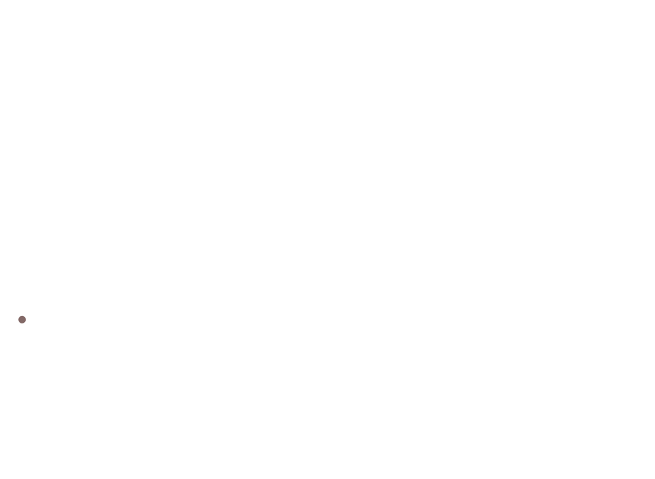
Architecture
Decoder
ci
Instead of using a simple RNN, a bidirectional RNN is used.
This architecture helps to get the context of future words.
The attention model is a FFNN which takes the previous state of the decoder and the current output of the encoder to produce a fixed set of outputs based on a window size T.
$c_{i}=\sum_{j=1}^{T_{x}}{α_{ij}h_{j}}$ where $α_{ij}$ is normalized using softmax function.
Later, these outputs, $α_{t,T}$, are multiplied with the output $h_{t}$ to produce the context vector C.
Encoder

Slide 29
Transformer
Attention is All You Need

Slide 30
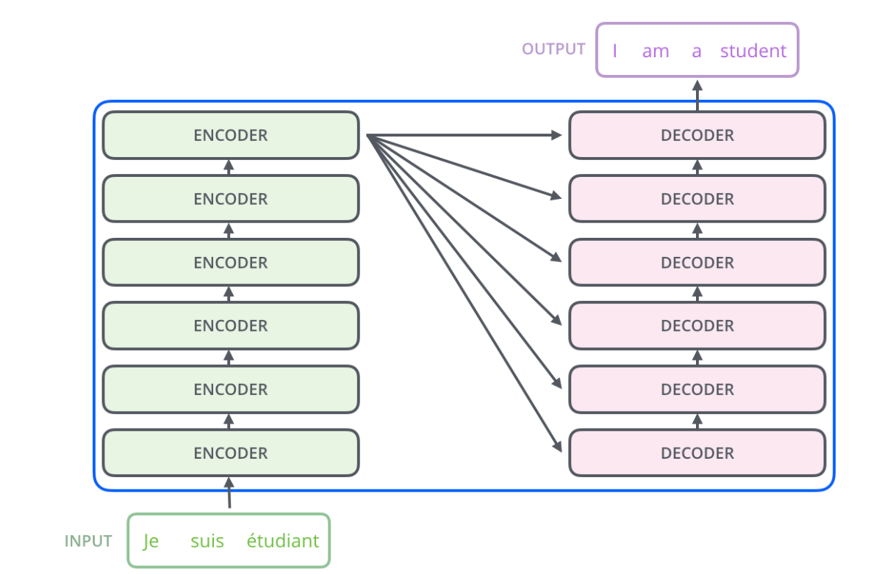
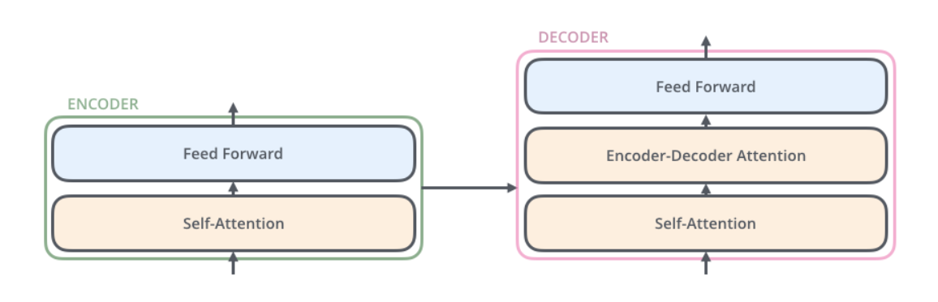
Architecture

Slide 31
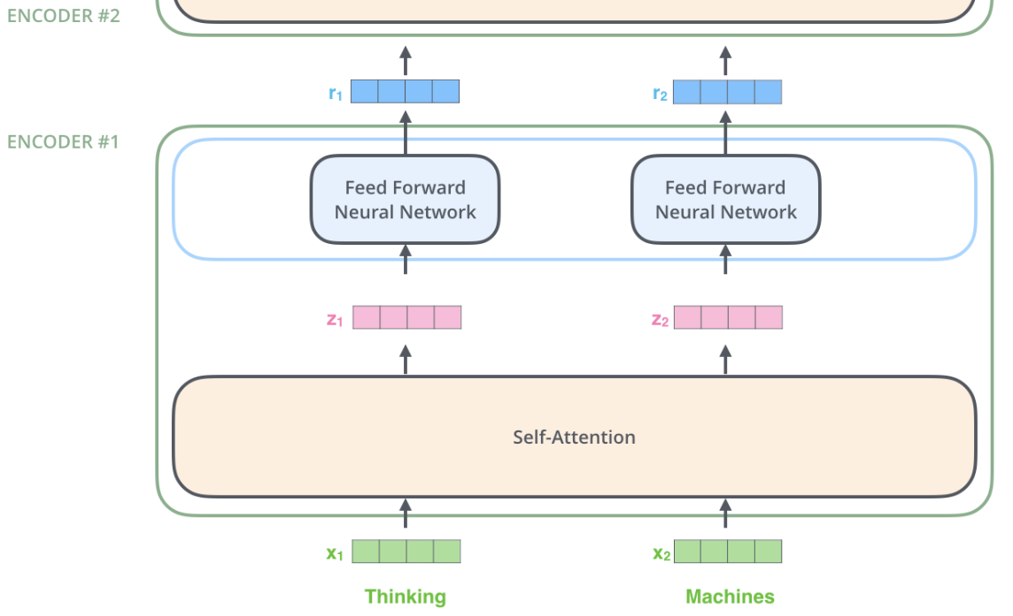
Encoder Working

Slide 32
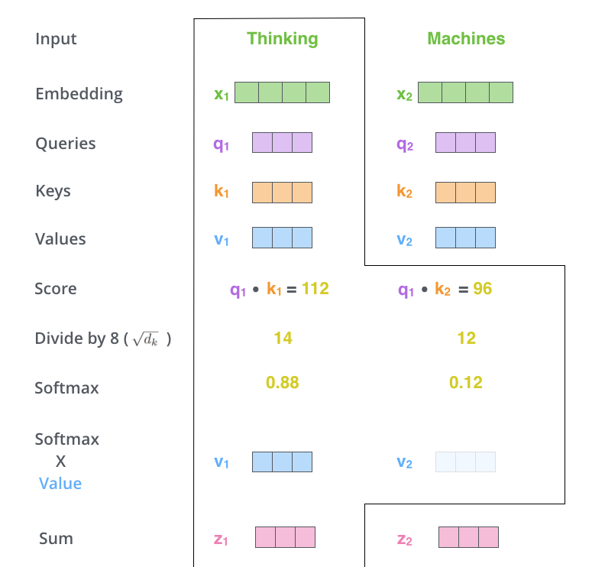
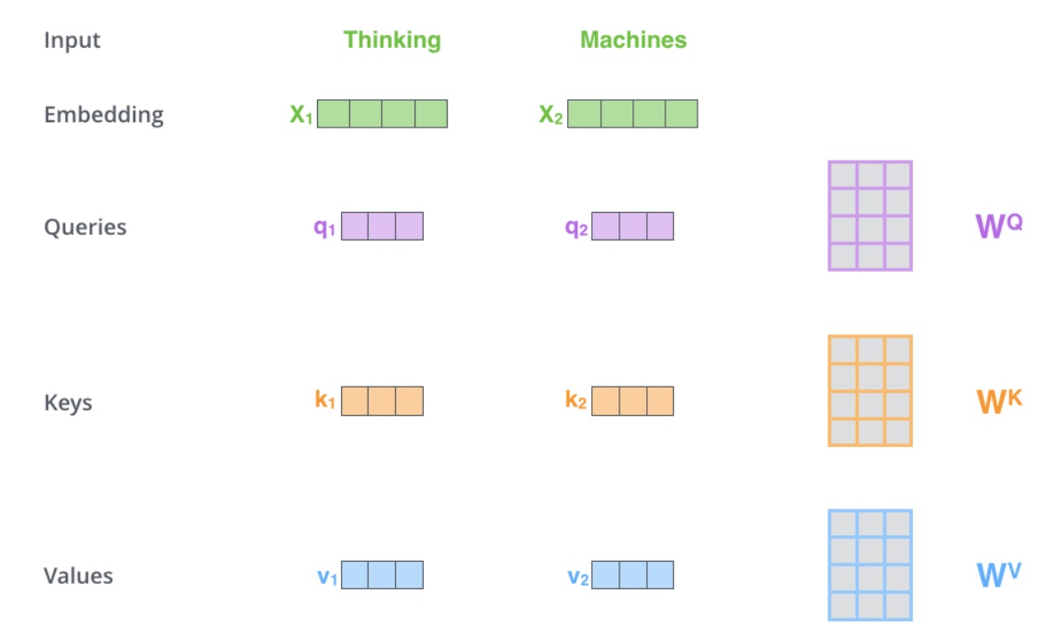

Slide 33
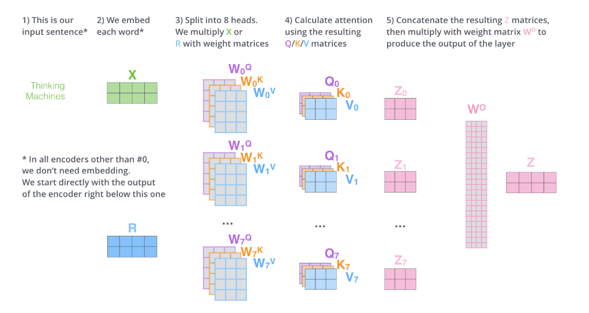

Slide 34
Explanation of working
The encoder start by processing the input sequence. The output of the top encoder is then transformed into a set of attention vectors K and V.
The output of each step is fed to the bottom decoder in the next time step, and the decoders bubble up their decoding results just like the encoders did.
Just like the encoder inputs, embedding and positional encoding is done to those decoder inputs to indicate the position of each word.

Slide 35
Explanation of working
The self attention layers in the decoder operate in a slightly different way than the one in the encoder:
In the decoder, the self-attention layer is only allowed to attend to earlier positions in the output sequence. This is done by masking future positions.
The “Encoder-Decoder Attention” layer works just like multiheaded self-attention, except it creates its Queries matrix from the layer below it, and takes the Keys and Values matrix from the output of the encoder stack.

Slide 36
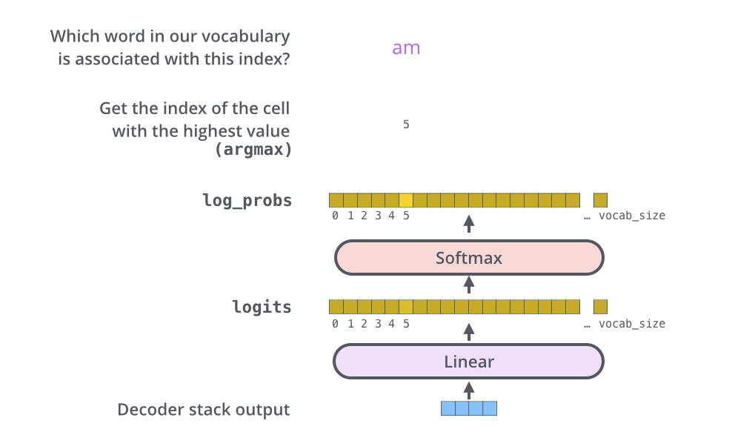
Final Layer

Slide 37
Bidirectional Encoder Representations from Transformers (BERT)

Slide 38
BERT model
BERT architecture consists of several Transformer encoders stacked together. Each Transformer encoder encapsulates two sub-layers: a self-attention layer and a feed-forward layer.
There are two different BERT models:
BERT base, which is a BERT model consists of 12 layers of Transformer encoder, 12 attention heads, 768 hidden size, and 110M parameters.
BERT large, which is a BERT model consists of 24 layers of Transformer encoder,16 attention heads, 1024 hidden size, and 340 parameters.

Slide 39
Why BERT is a powerful language model
There are at least two reasons:
It is pre-trained on unlabeled data extracted from BooksCorpus, which has 800M words, and from Wikipedia, which has 2,500M words.
As the name suggests, it is pre-trained by utilizing the bidirectional nature of the encoder stacks. This means that BERT learns information from a sequence of words not only from left to right, but also from right to left.

Slide 40
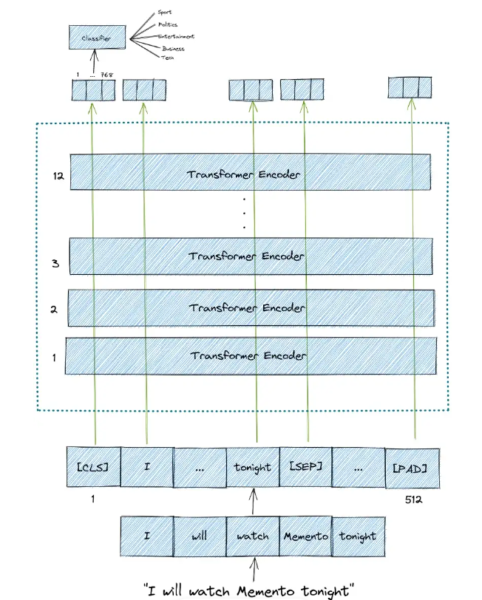
BERT Architecture and working overview

Slide 41
Context Learning in BERT
Bert learns the context using 2 methods:
Masked Language Model (MLM)
Next Sentence Prediction (NSP)

Slide 42
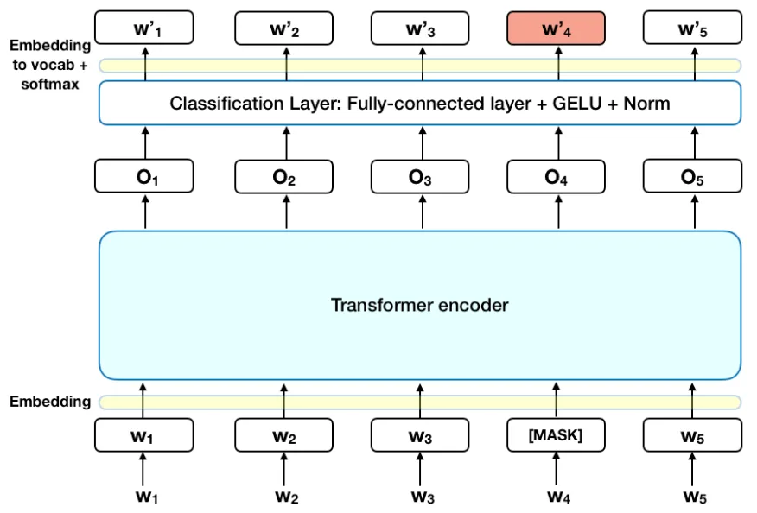
Masked Language Model
Before feeding word sequences into BERT, 15% of the words in each sequence are replaced with a [MASK] token. The model then attempts to predict the original value of the masked words, based on the context provided by the other, non-masked, words in the sequence. In technical terms, the prediction of the output words requires:
Adding a classification layer on top of the encoder output.
Multiplying the output vectors by the embedding matrix, transforming them into the vocabulary dimension.
Calculating the probability of each word in the vocabulary with softmax.
The BERT loss function takes into consideration only the prediction of the masked values and ignores the prediction of the non-masked words.

Slide 43
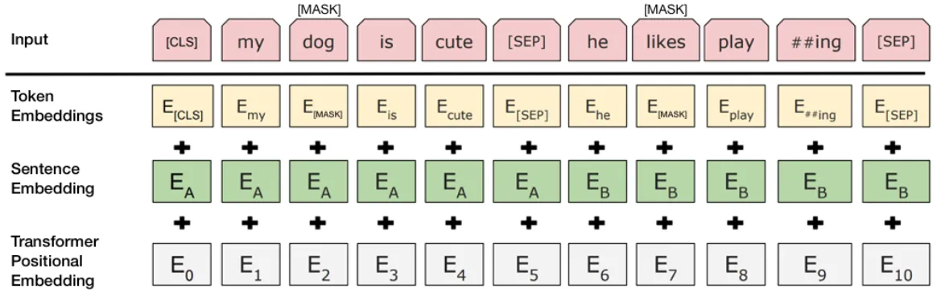
Next Sentence Prediction
In the BERT training process, the model receives pairs of sentences as input and learns to predict if the second sentence in the pair is the subsequent sentence in the original document. During training, 50% of the inputs are a pair in which the second sentence is the subsequent sentence in the original document, while in the other 50% a random sentence from the corpus is chosen as the second sentence. The assumption is that the random sentence will be disconnected from the first sentence.
To help the model distinguish between the two sentences in training, the input is processed in the following way before entering the model:
A [CLS] token is inserted at the beginning of the first sentence and a [SEP] token is inserted at the end of each sentence.
A sentence embedding indicating Sentence A or Sentence B is added to each token. Sentence embeddings are similar in concept to token embeddings with a vocabulary of 2.
A positional embedding is added to each token to indicate its position in the sequence. The concept and implementation of positional embedding are presented in the Transformer paper.

Slide 44
Fine-tuning BERT
BERT can be used for a wide variety of language tasks, while only adding a small layer to the core model:
Classification tasks such as sentiment analysis are done similarly to Next Sentence classification, by adding a classification layer on top of the Transformer output for the [CLS] token.
In Question Answering tasks (e.g. SQuAD v1.1), the software receives a question regarding a text sequence and is required to mark the answer in the sequence. Using BERT, a Q&A model can be trained by learning two extra vectors that mark the beginning and the end of the answer.
In Named Entity Recognition (NER), the software receives a text sequence and is required to mark the various types of entities (Person, Organization, Date, etc) that appear in the text. Using BERT, a NER model can be trained by feeding the output vector of each token into a classification layer that predicts the NER label.
In the fine-tuning training, most hyper-parameters stay the same

Slide 45
Next Sentence Prediction
To predict if the second sentence is indeed connected to the first, the following steps are performed:
The entire input sequence goes through the Transformer model.
The output of the [CLS] token is transformed into a 2×1 shaped vector, using a simple classification layer (learned matrices of weights and biases).
Calculating the probability of IsNextSequence with softmax.
When training the BERT model, Masked LM and Next Sentence Prediction are trained together, with the goal of minimizing the combined loss function of the two strategies.

Slide 46
Graph Neural Networks

Slide 47
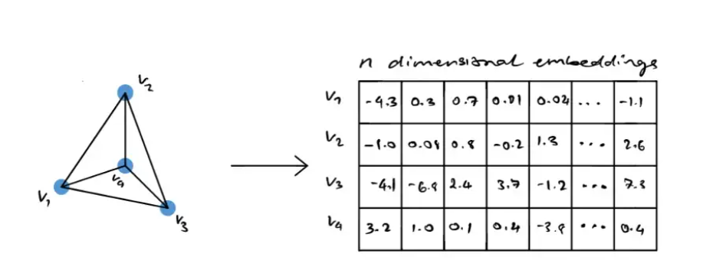
Graph Embedding

Slide 48
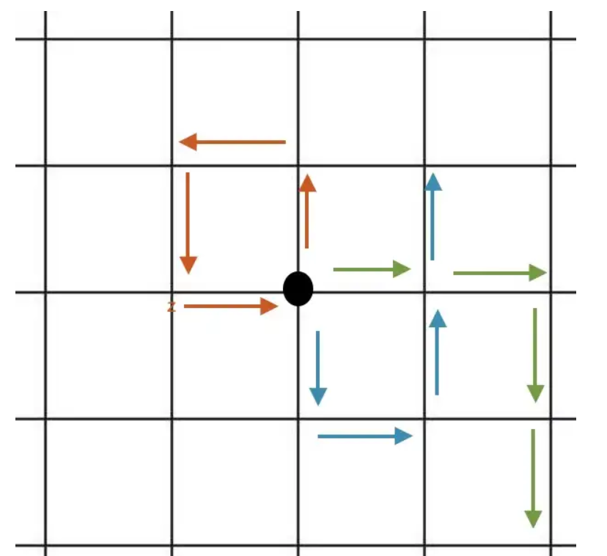
Random Walk
A random walk is a type of stochastic process. The simplest explanation of a random walk would be through walking.
This implies that at each index of time, one moves in a certain direction based on a probabilistic outcome.

Slide 49
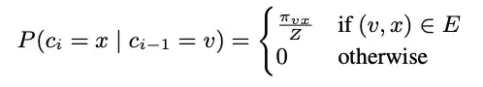
Working
The probability of random is calculated as follows:
Node2Vec introduces the following formula for determining the probability of moving to the node x given that previously at the node v.
Where z is the normalization constant, and πvx is the unnormalized transition probability between nodes x and v . If there is no edge connecting x and v, then the probability will be 0, but if there is an edge, we identify a normalized probability of going from v to x.

Slide 50
Guided Random Walk
The paper states that the easiest way to introduce a bias to influence the random walks would be if there was a weight associated with each edge. However, that wouldn’t work in the case of unweighted networks.
To resolve this, the authors introduced a guided random walk governed by two parameters p and q.
p indicates the probability of a random walk getting back to the previous node, and q indicates the probability that a random walk can pass through a previously unseen part of the graph.

Slide 51
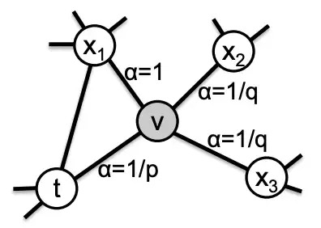
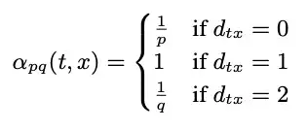
Guided Random Walk

Slide 52
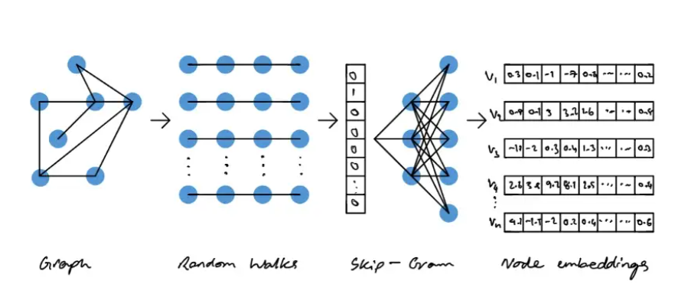
Node2Vec

Slide 53
Explanation
The process for node2vec begins by inputting a graph and extracting a set of random walks from the input graph.
The walks can then be represented as a directed sequence of words where each node represents a word.
The generated random walks are then passed into the skip-gram model. The skip-gram model works on words and sentences, each node in the random walk can be represented as a word and the entire walk can be represented as a sentence.
The result of the skip-gram model yields an embedding for each node (or word in this analogy).

Slide 54
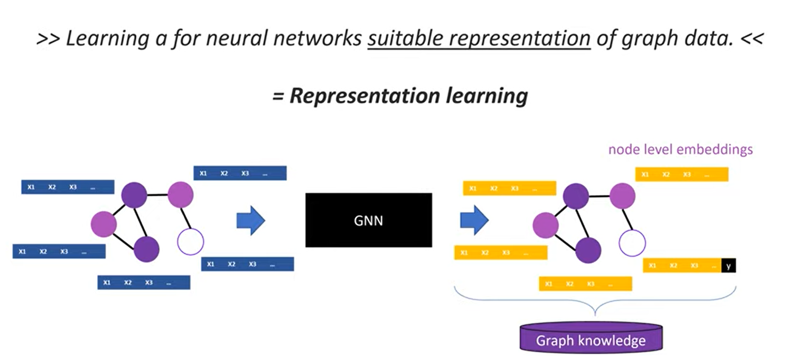
Graph Neural Networks
Has several message passing layers

Slide 55
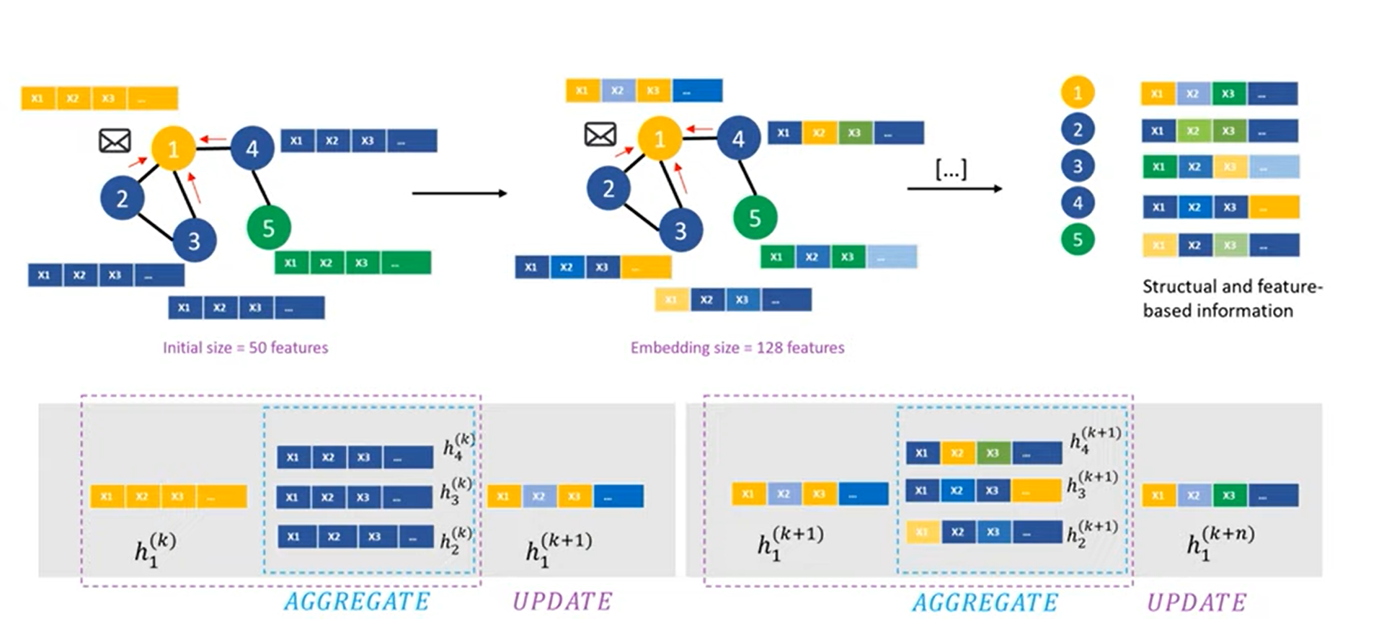
Working of Message Passing Layers

Slide 56
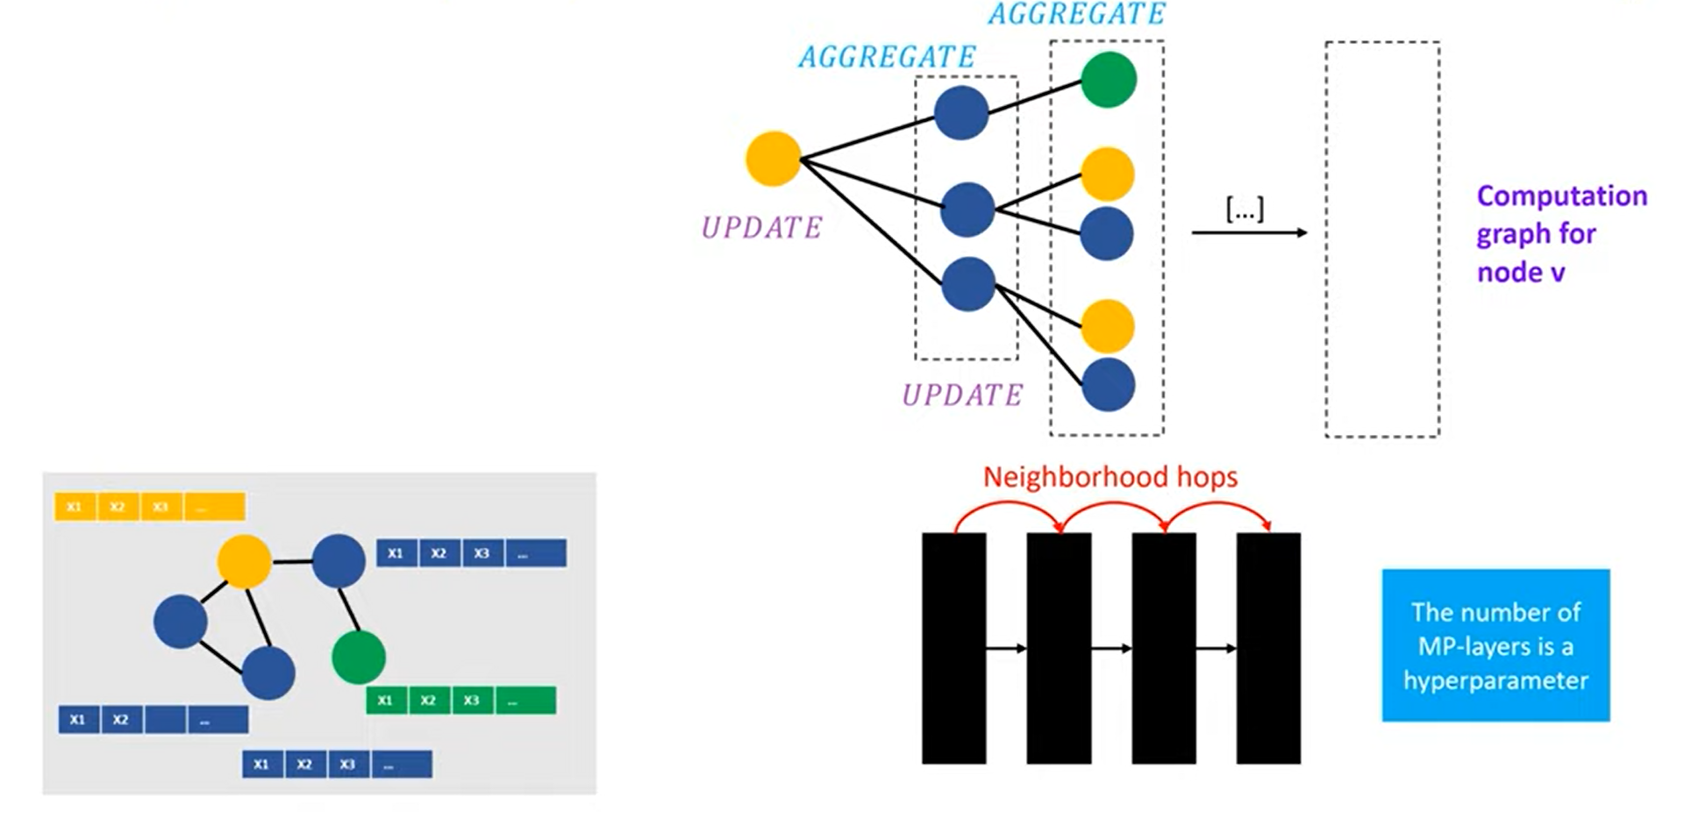
Computation Graph Representation

Slide 57
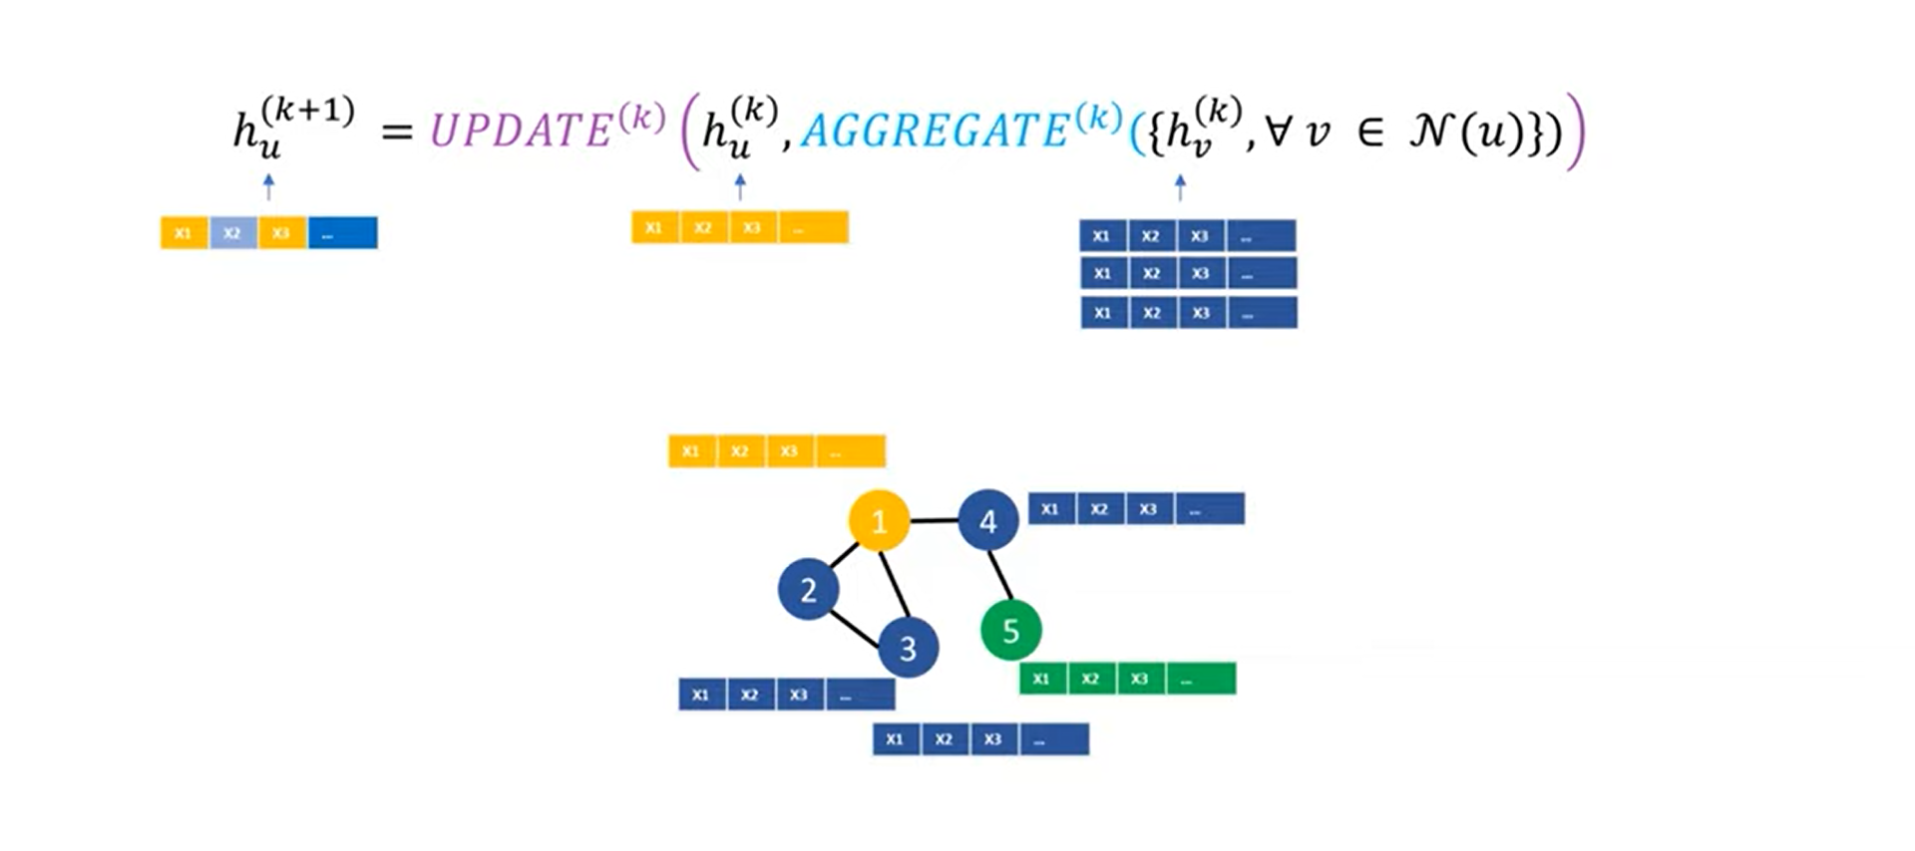
Message Passing Update and Aggregate Functions

Slide 58
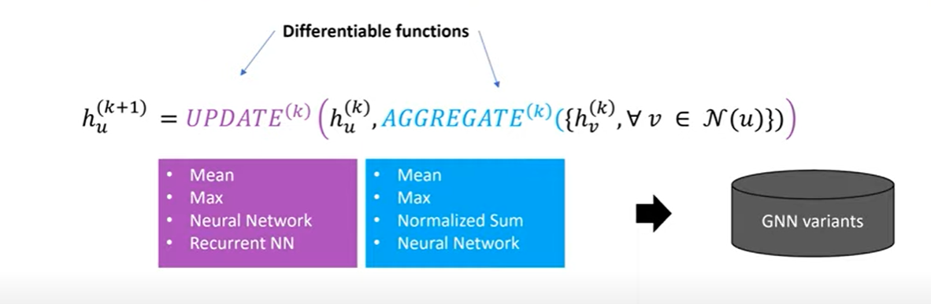
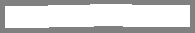
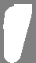
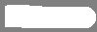
Message Passing Update and Aggregate Functions

Slide 59
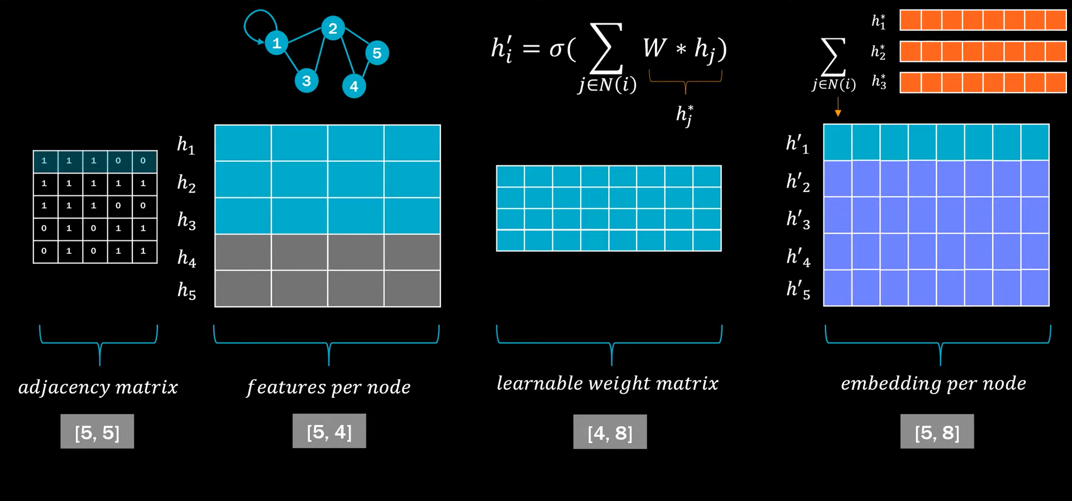
GNN Overview

Slide 60
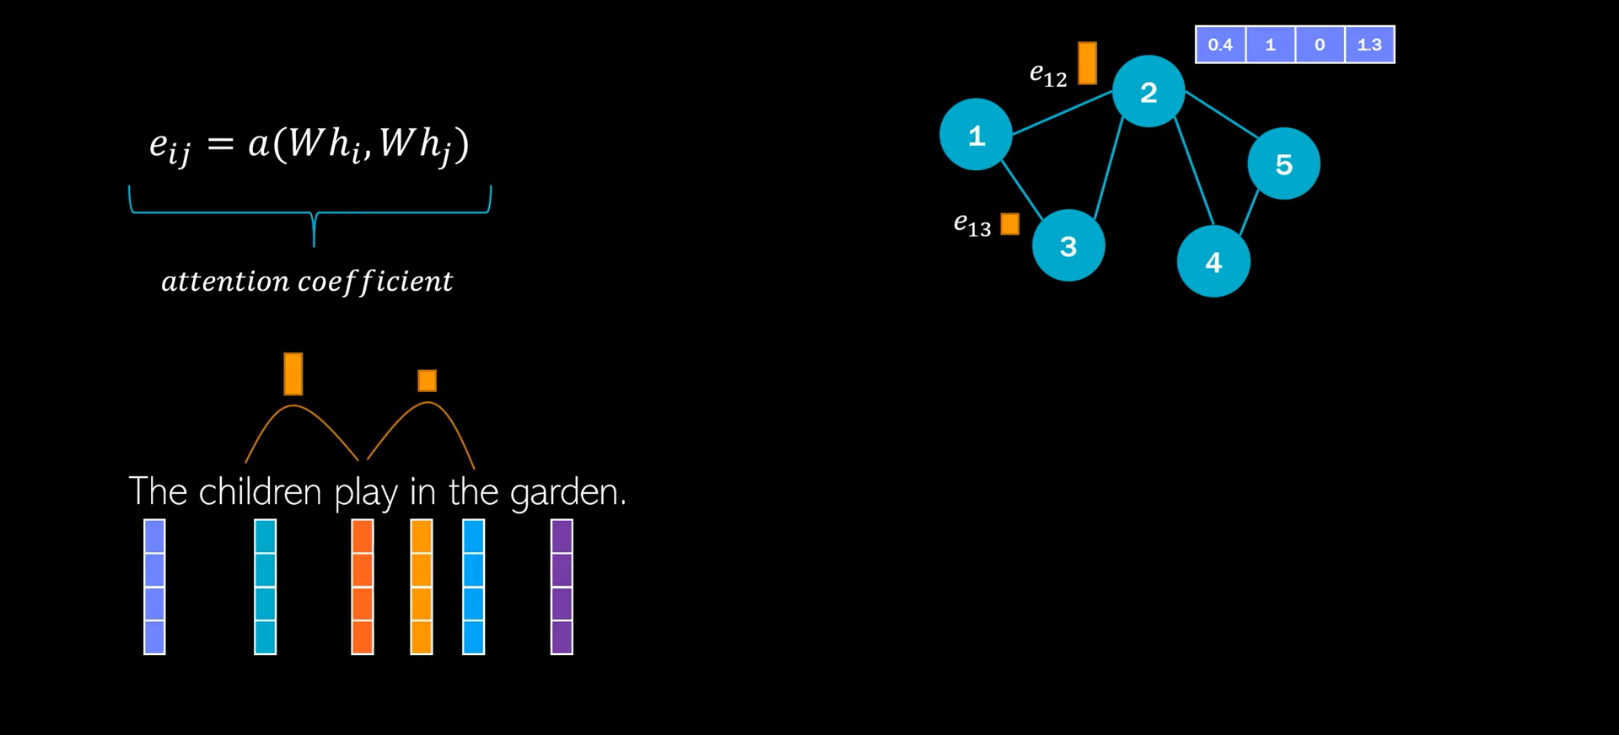
Graph Attention Network

Slide 61
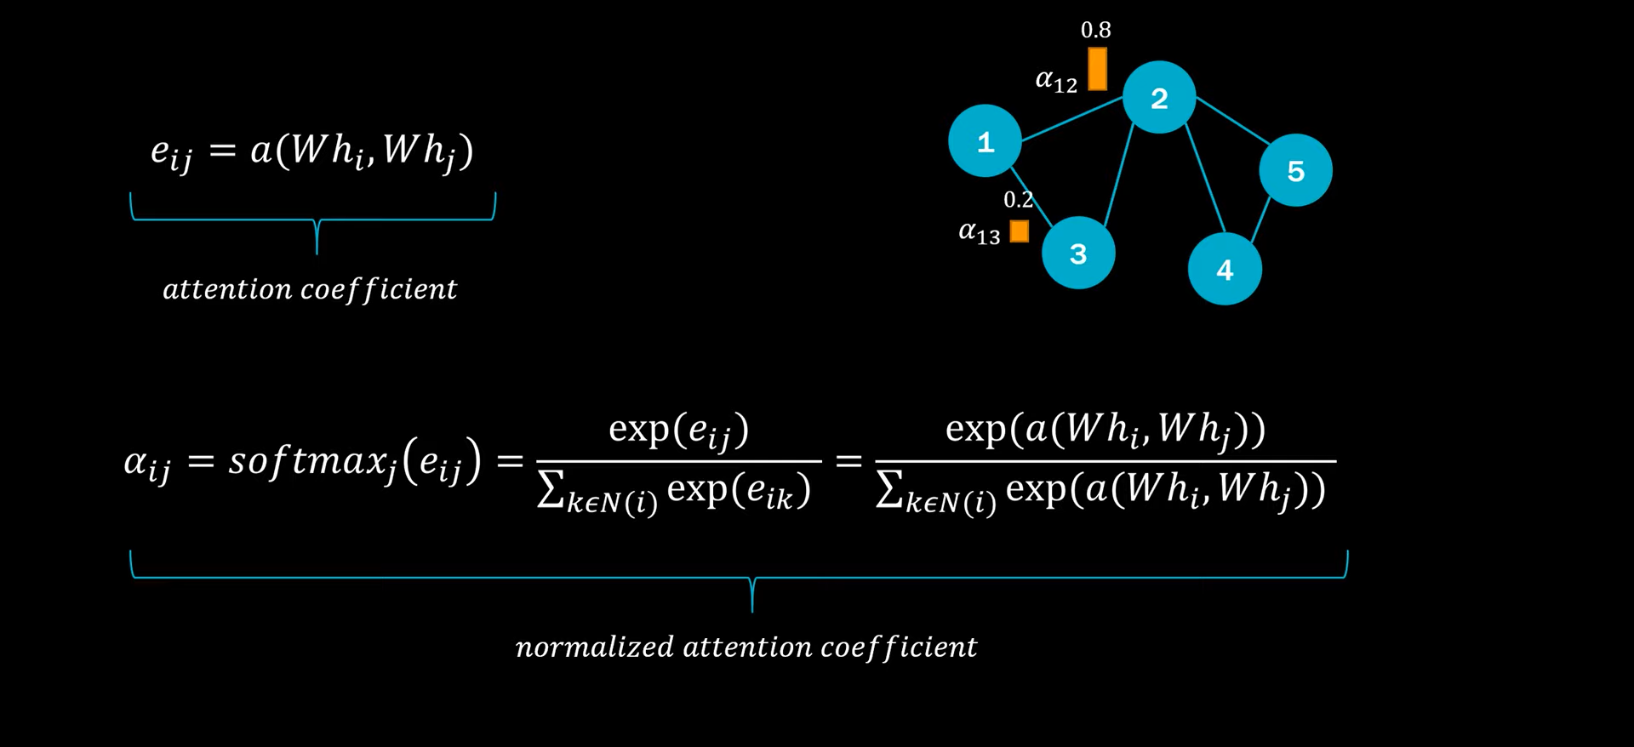
Graph Attention Network

Slide 62
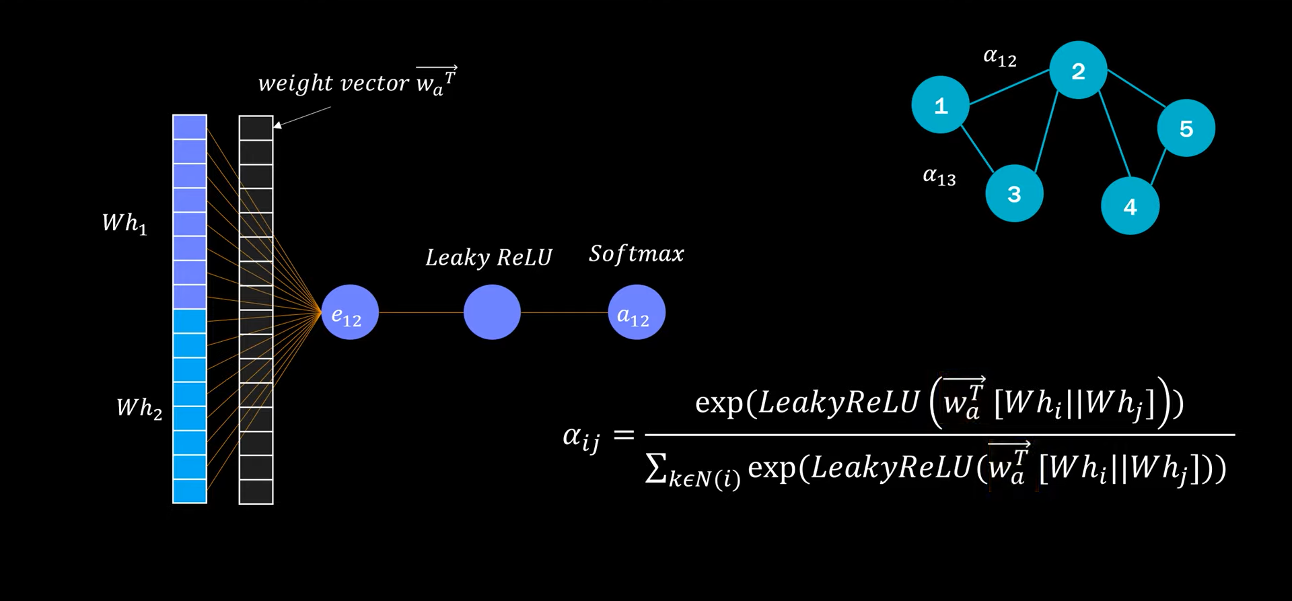
Graph Attention Network

Slide 63
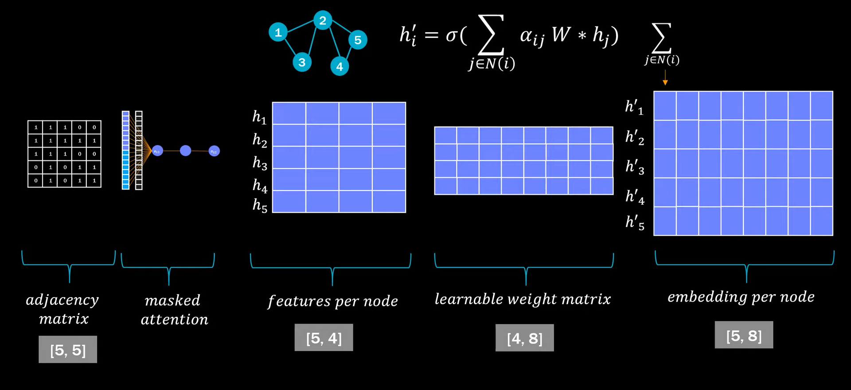
Graph Attention Network

